Slide 1
Breaking Boundaries: Large Language Models as Atari Breakout Agents
CRE Team 3 - MCS 5623
Nicholas Paul
Nazeer Uddin Syed
Siri Sri Churakanti
Team 3: Nicholas Paul, Nazeer Syed, Siri Sri Churakanti

Slide 2
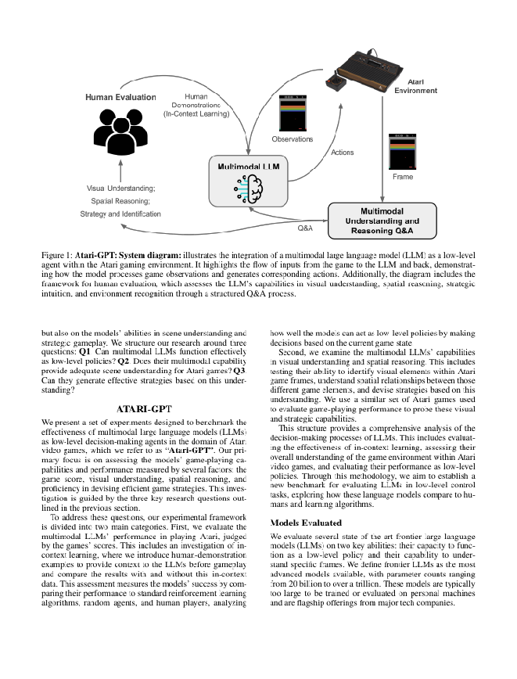
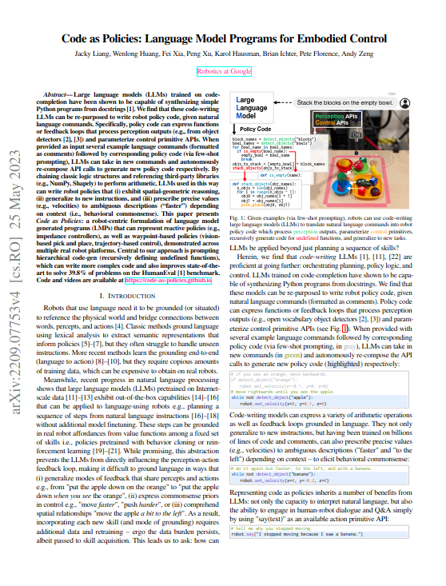
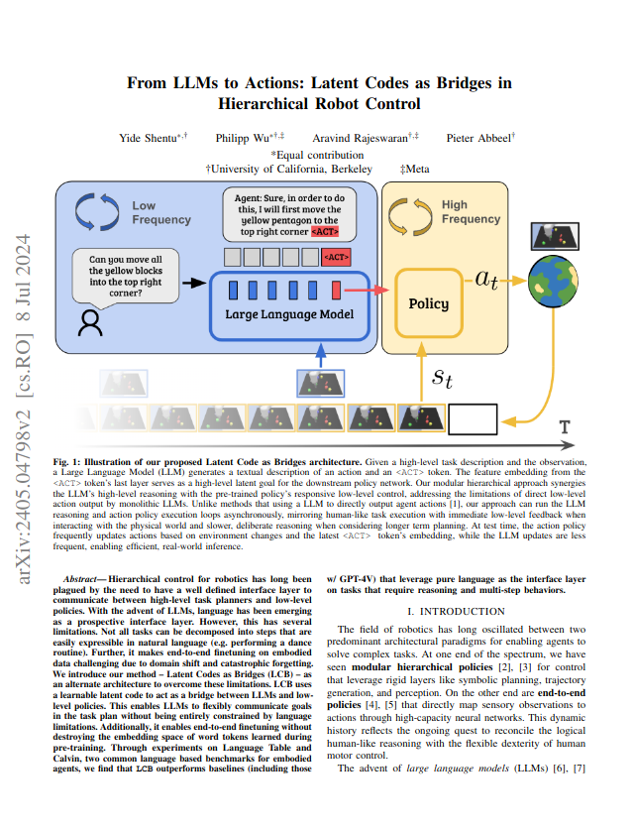
Objectives
LLM as a Agent
Evaluate an LLM as a low level agent
Recent papers such as Atari-GPT (2024) used an LLM as an agent directly. Scores on some games were good but Breakout had poor performance and could potentially be improved.
Atari-GPT
(2024)
LLM as an Agent Generator
Evaluate an LLM as a tool to generate low level agents
Papers such as Code as Policies (2023) and From LLMs to Actions (2024) use LLMs to generate policies as code rather than evaluate the policy directly.
From LLMs to Actions
(2024)
Code as Policies
(2023)

Slide 3
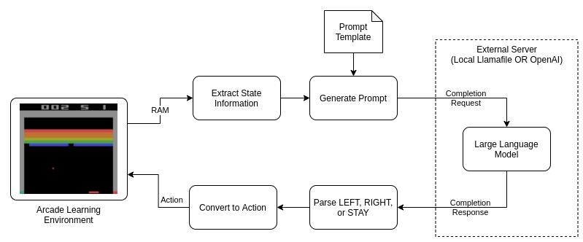
METHODOLOGY: LLM AS AN AGENT
Text Representation
Reasoning
Action Selection
Extract world state into a text format and insert it into a prompt template
Large language reason about the world state and generates a response
An action is selected based on the response and applied to update the state

Slide 4
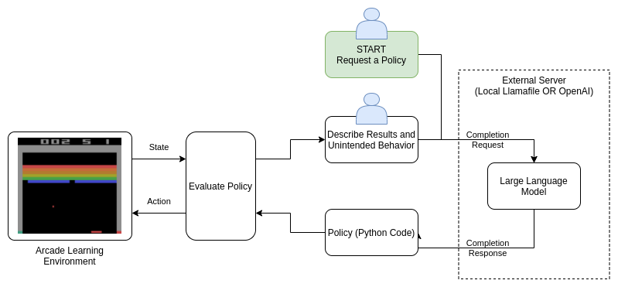
METHODOLOGY: LLM AS AN AGENT GENERATOR
Initial Agent Request
Evaluation
Iterate
User requests an agent from the LLM to accomplish a low level task
Evaluate the agent on the environment
Human in the loop describes issues and requests an updated policy from the LLM

Slide 5

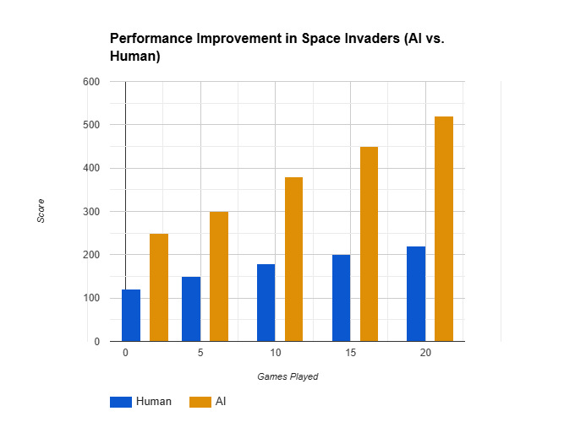
KEY FINDINGS
Generalization Across Games
Consistent architecture used across seven Atari games.
No modifications to CNN.
Demonstrates adaptability and generalization.
Out Performed Previous Approaches
Achieved superior performance in six out of seven games.
Learned features directly from raw pixel data, improving flexibility and resilience.

Slide 6
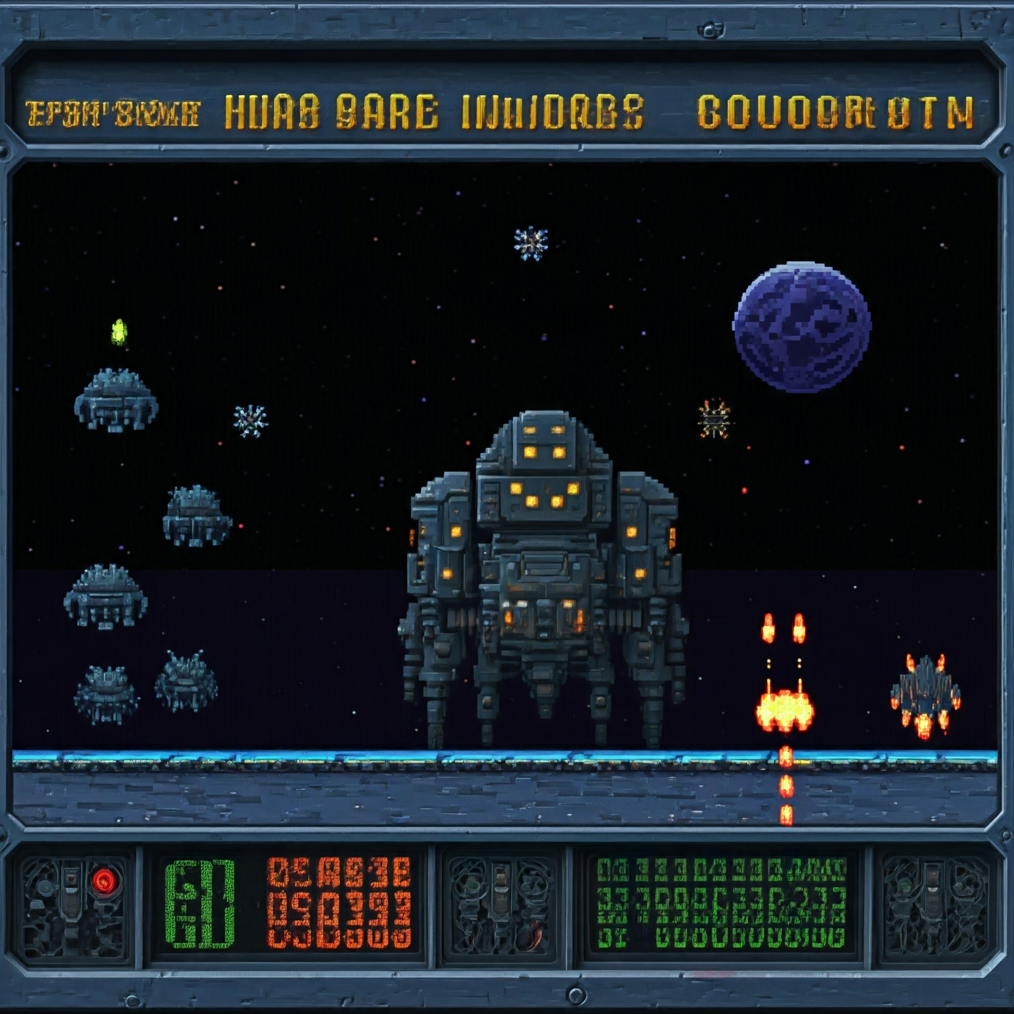



Surpassed Human Experts
Outperformed human experts in three games.
Devised advanced strategies in Space Invaders and precise paddle control in Breakout.
Potential for Broader Applications
Potential applications: robotics, autonomous driving, and healthcare.
Model learns autonomously through interaction.

Slide 7
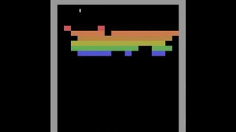
"AI Learns to Play: Deep Reinforcement Learning with Atari"

Slide 8
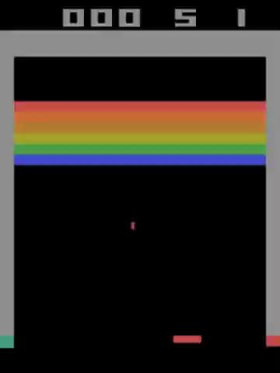
Here is a video where LLM predicts where the ball would land from the prompt.

Slide 9
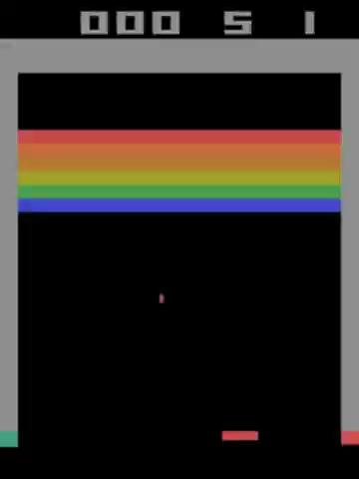
"Key Insights from AI Gameplay and Performance"
Observe significant moments where the AI makes critical decisions that lead to high scores.
Note when the AI first starts learning and when it begins to show advanced strategies.
As the AI trains, its scores increase over time, showcasing the power of deep reinforcement learning.
These videos illustrate the model’s superiority in certain scenarios compared to human players and traditional RL methods.
This video showcases the AI using Python code generated by the LLM.
It achieved a total score of 405.

Slide 10

Ideas for Future Research
Enhancing Efficiency
Optimize prompts and explore lightweight LLMs for faster decision-making.
Reduce latency for real-time applications.
Integrating Visual Processing
Combine LLMs with vision-based models for direct game frame interpretation.
Leverage multimodal LLMs to handle both text and visual data.
Expanding Applicability
Test adaptability on other games and complex environments.
Explore hybrid models integrating rule-based AI and reinforcement learning.
Real-World Impact
Extend LLM decision-making to robotics and real-time systems.
Investigate collaborative AI for human-assisted gameplay and control.

Slide 11
Conclusion
This project investigated varied methods of controlling the paddle in Atari Breakout, from rule-based algorithms to Large Language Models (LLMs) and human performance as the baseline. By comparing these approaches, we see that rule-based methods are efficient for control and determined. On the other hand, LLMs are flexible in unknown game states and unpredictable human opponent actions by interpreting them in prompt format from text cues, albeit without training.
In this study, we have seen that while either method provides his pros and cons, in combination lies an even richer promise. This study illustrates ways in which AI can tackle dynamic tasks, with exciting breakthroughs in future research in gaming, robotics, and other fields.

Slide 12
Thanks !

